Slide 1

Data Literacy with Tableau
Project Title
Unlocking Insights into The Global Air Transportation Network with Tableau

Slide 2

Team Profile
NM TEAM ID NM2023TMID13717
TEAM LEADER - SARANYA T
TEAM MEMBER
VIJAYALAKSHMI M
SWETHA S
POOJA P

Slide 3
Under the guidance of
Dr. P. Puviarasu, M.Sc., B.Ed., M.phil.,PGDCA.,
Assistant professor
UG & PG Department of Mathemetics,
Government Thirumagal Mill’s College,
Gudiyattam-632602.

Slide 4
INTRODUCTION
1.overview:
This Global Air Transportation Network dataset is a comprehensive collection of information on airports, airlines and their routes. It contains information such as names, cities, countries, codes (IATA and ICAO) longitudes, latitudes and altitudes of airports across the world with detailed time zone and daylight 0f saving time data. Additionally, this includes information about airlines including their IDs, name aliases, IATA and ICAO codes, callsigns country of origin and active/inactive status. Similarly, it also covers route details such as airline sources to destination airports along with essential details like codeshare stakeholder if any stops required during this journey along with the type of aircraft being used for that particular journey. This dataset has been compiled through meticulous labour by researchers all over the world to give you a comprehensive detail into air transportation networks from around the globe.

Slide 5
2.PURPOSE:
Air transport is the transport of goods and passengers through airways.
Air transport allows people different countries to cross international boundaries and travel other countries for personal, business medical, and tourism purposes.

Slide 6
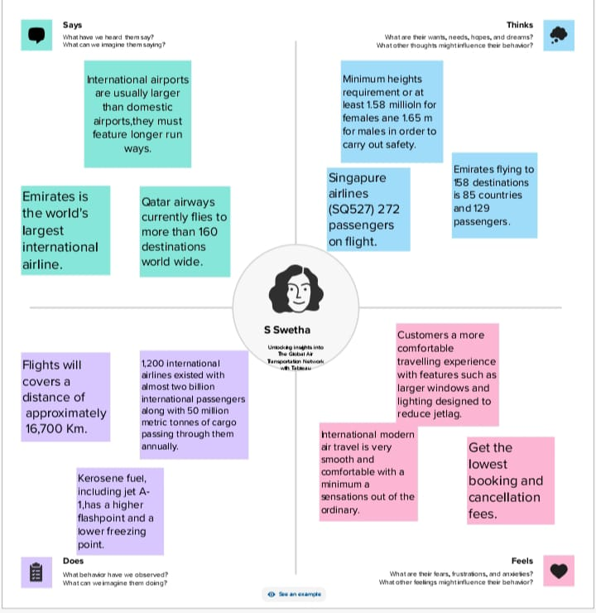
PROBLEM DEFINING&DESIGN THINKING

Slide 7
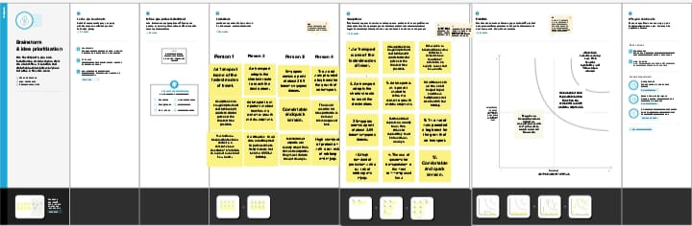
BRAIN STRORMING MAP

Slide 8
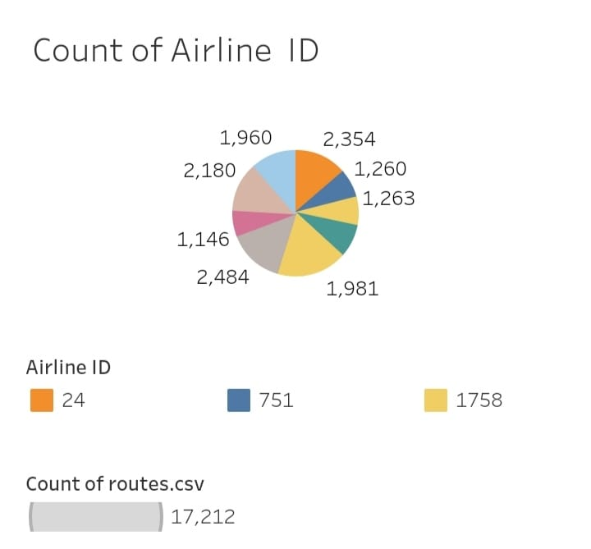
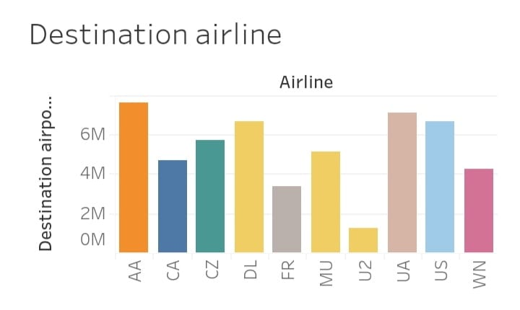
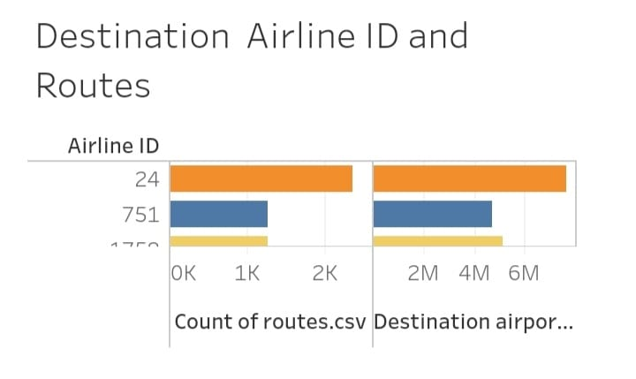
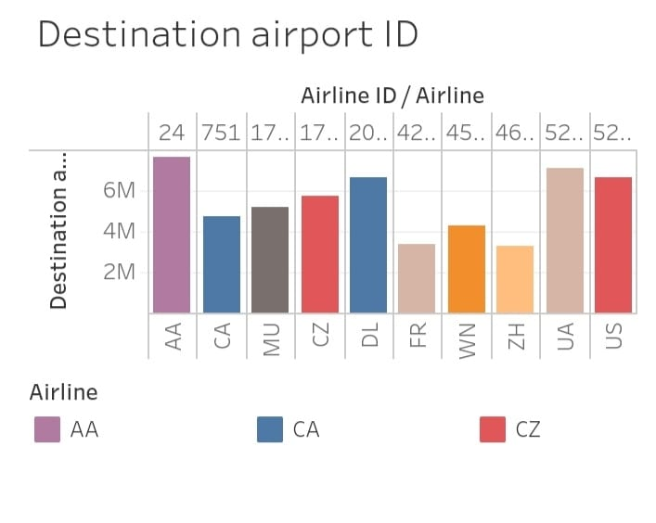
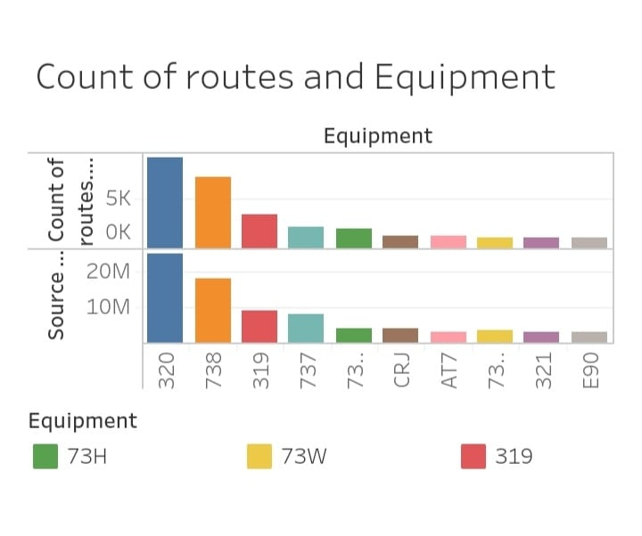
RESULT
DASHBOARD:

Slide 9
STORY

Slide 10
THANKING YOU

